Slide 1
AI CPS Project Proposal
Project Motivation:
By Team Cascade (Lohith ,Adnan, Raj, Rahul, Dr.Sikander)
We want to contribute to the rapid growth and development of the Agriculture sector which is now being treated with numerous cutting edge technologies in order to improve things such as crop yield etc, stubble burning and other sort of excess waste that is generated is also a point of concern for us and drives us to pursue the following Project.

Slide 2


1. Features and scope
App development Get front end part done for agriculture based app
AI model Planning to develop a model for crop recommendation and integrate it with android application, creation of weed detection model, Land Yield prediction model.
Live feed/monitoring This will allow user to track the different field and soil parameters in real time.
Multilingual app will have a multilingual lay out for farmer’s ease of access.
Government schemes Will feed user with Latest government schemes
Weather forecasting will provide a weather forecasting feature

Slide 3
2. Technology stack
Softwares
Android studio, Jupyter Notebook, Google collab, Flutter, Arduino IDE.
Resources
Kaggle, GitHub, APIs, government websites and data regarding agriculture.
Languages
Python , C++ , Dart.

Slide 4
Progress Report
(Team Cascade)

Slide 5
Progress with regards to ML models
Previous: Crop Recommendation Algorithm generated by implementing KNN, Decision Tree, Random forest, etc for determining the best type of crop to sow at any particular time/season along with laying down a hierarchy of factors responsible for optimum crop yield.
New Developments: Data set of millet crops was taken and was passed through various ML algorithms and future crop yield was estimated with an accuracy of 71.85%

Slide 6
Crop Recommendation

Slide 7
Summary for Crop Recommendation
We have used dataset of Indian Council of Agricultural Research(ICAR) available in Kaggle.It has 2200 rows and 8 columns.It has 7 features to label the 22 crops.
After EDA, We found out that rainfall, humidity and K value is very important for crop recommendation.
KNN, Support Vector Classifier, Decision Tree, Random Forest and Gradient boosting were employed to train the model and crop recommendation. Gradient boosting gives best performance among the machine learning models with 99.27% accuracy.

Slide 8
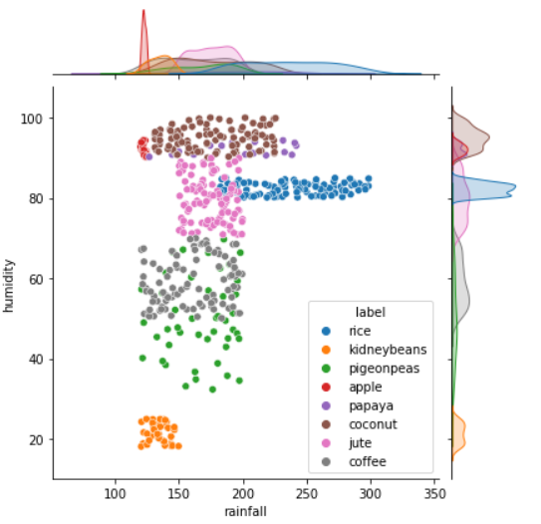
Rainfall vs Humidity (For T > 30 & Rainfall > 120mm)

Slide 9
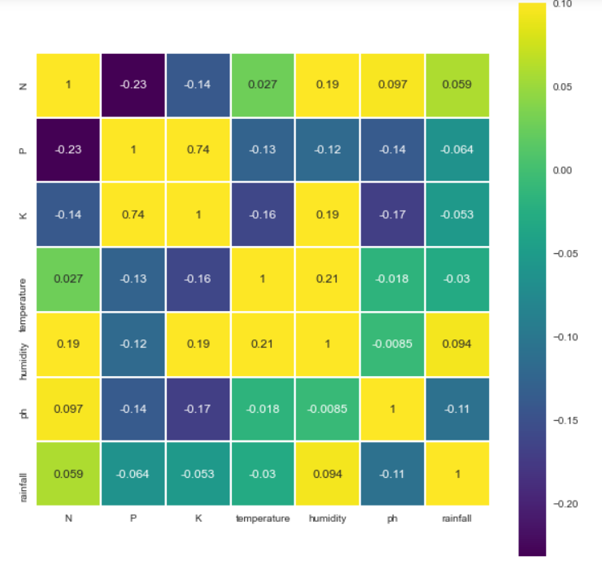
Heatmap

Slide 10
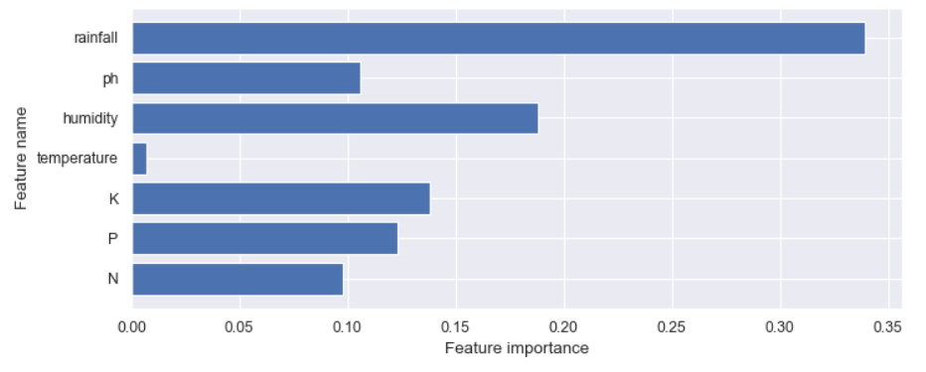
Feature importance (Decision Tree)

Slide 11
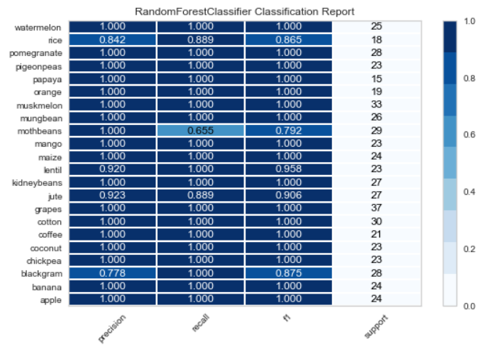
Random Forest Classification Report

Slide 12
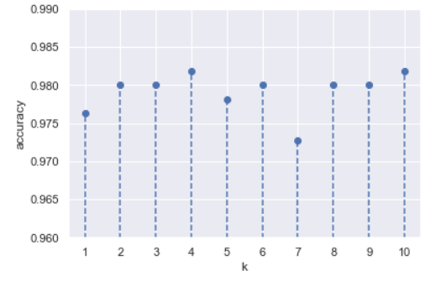
Accuracy w.r.t. k value (KNN)

Slide 13
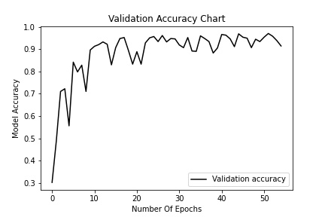
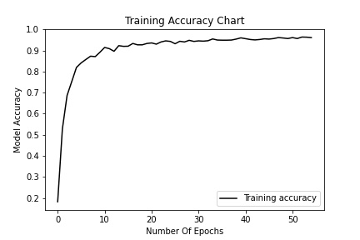
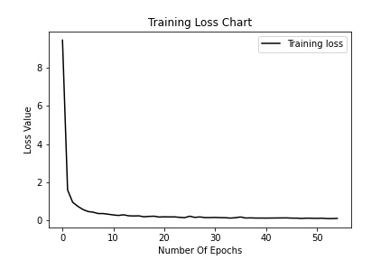
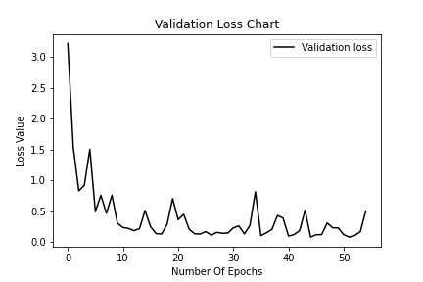
Crop Recommendation using ANN
These are the Training Accuracy,Training Loss,Validation Accuracy,Validation Loss graphs using ANN model .

Slide 14
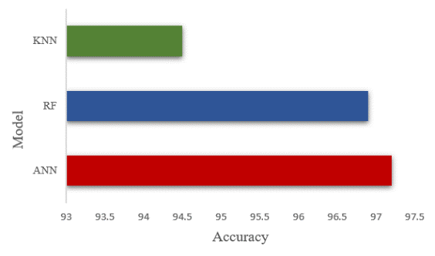
Continued..
S. No | Layers | Train Accuracy | Train loss | Validation Accuracy | Validation loss
1 | 64 x 64 x 22 | 0.949 | 0.121 | 0.955 | 0.129
2 | 64 x 64 x 64 x 22 | 0.969 | 0.086 | 0.964 | 0.098
3 | 128 x 64 x 32 x 22 | 0.972 | 0.065 | 0.971 | 0.078
4 | 128 x 64 x 64 x 22 | 0.969 | 0.072 | 0.962 | 0.093
5 | 256 x 64 x 64 x 32 x 22 | 0.96 | 0.11 | 0.956 | 0.132
These are the Layers which we have used for testing the best Accuracy.
This is the comparison between the Models.

Slide 15
Crop Yield Prediction Model:
Models Used were Logistic Regression and Linear Regression.
Models take 10 ('Moisture', 'Rainfall', 'Average_Humidity', 'Mean_Temp', 'Max_Temp','Min_Temp', 'Alkaline', 'Sandy', 'Chalky', 'Clay') parameters as Input and predicts the Yield .
The results were :
Linear Regression with an r2 score of 13.822
Logistic regression with an accuracy of 76.2

Slide 16
Weed Detection Model
An image based model was created for weed detection using Convolutional Neural Networks (CNN) Wherein 4 activation layers and 3 Maxpool layers were used.

Slide 17
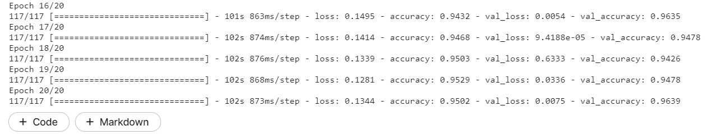
Training and Validation Accuracy and value loss of Model
After training the dataset with a testing to training ratio of 90:10, data was trained for a total of 20 epochs and the results are as follows:

Slide 18
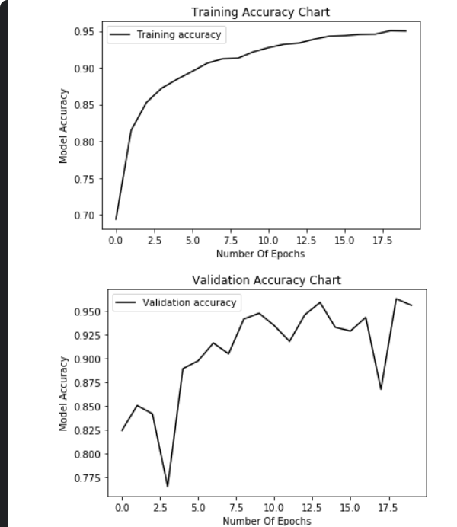
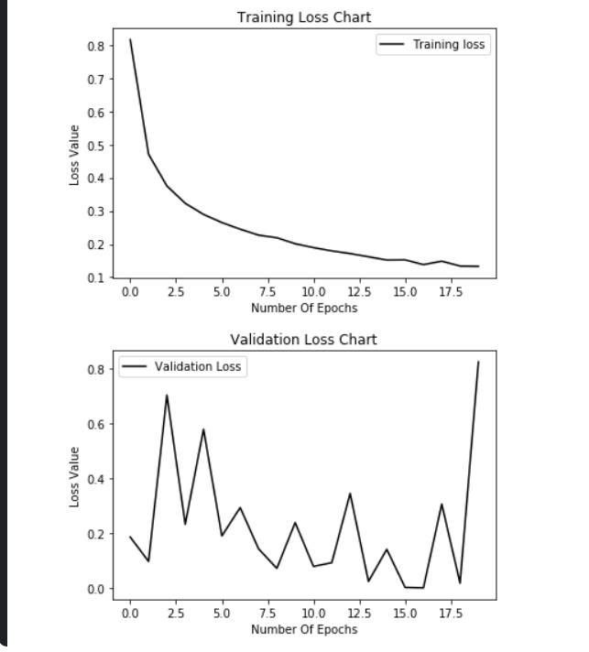
Results Illustration
These are the Training Accuracy,Training Loss,Validation Accuracy,Validation Loss graphs using CNN model .

Slide 19
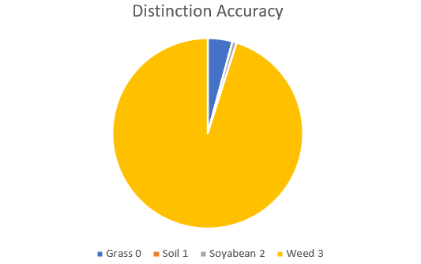
Final Result of Weed Detection Model
A total of 2299 Images belonging to 4 classes were processed, the results are as follows wherein the chart represents the amount of accuracy with which the model was able to distinguish each of the components. The overall accuracy being: 96.6%

Slide 20
Progress with regards to App Development
App supports multiple languages .
A section for live monitoring.
Live monitoring enables farmers to keep an eye on 3 important parameters that are surrounding temperature , humidity and soil moisture in real time.
A section detailing the various government schemes for farmers.
Weather forecasting feature.
A ML based Crop Recommendation model

Slide 21
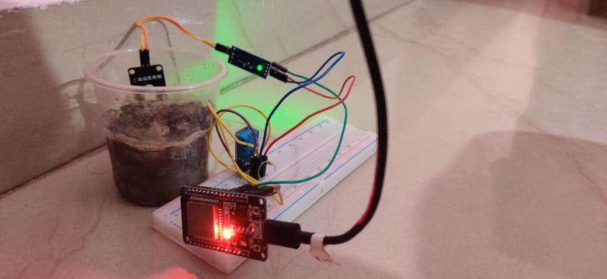
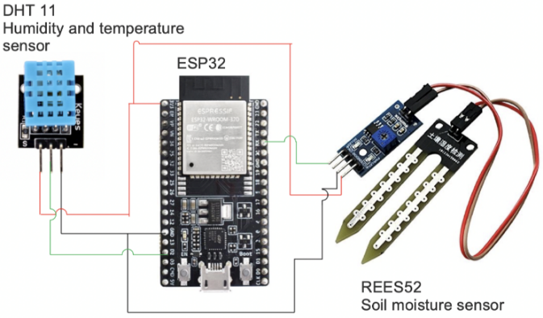
Hardware Setup Circuit diagram
Soil moisture sensor
DHT 11
ESP-32

Slide 22
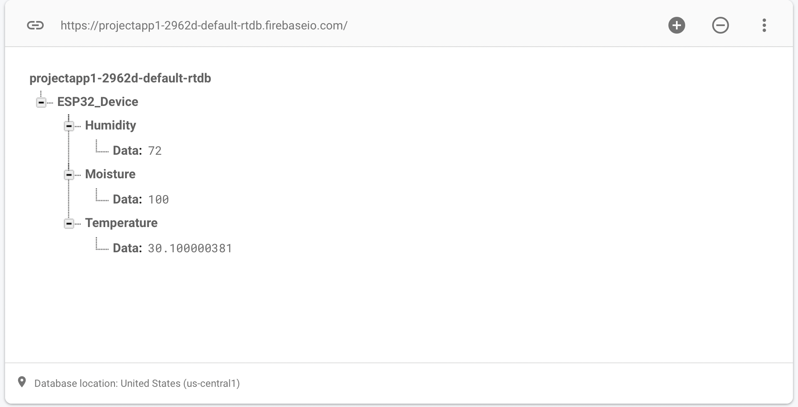
Data communicated to Firebase

Slide 23

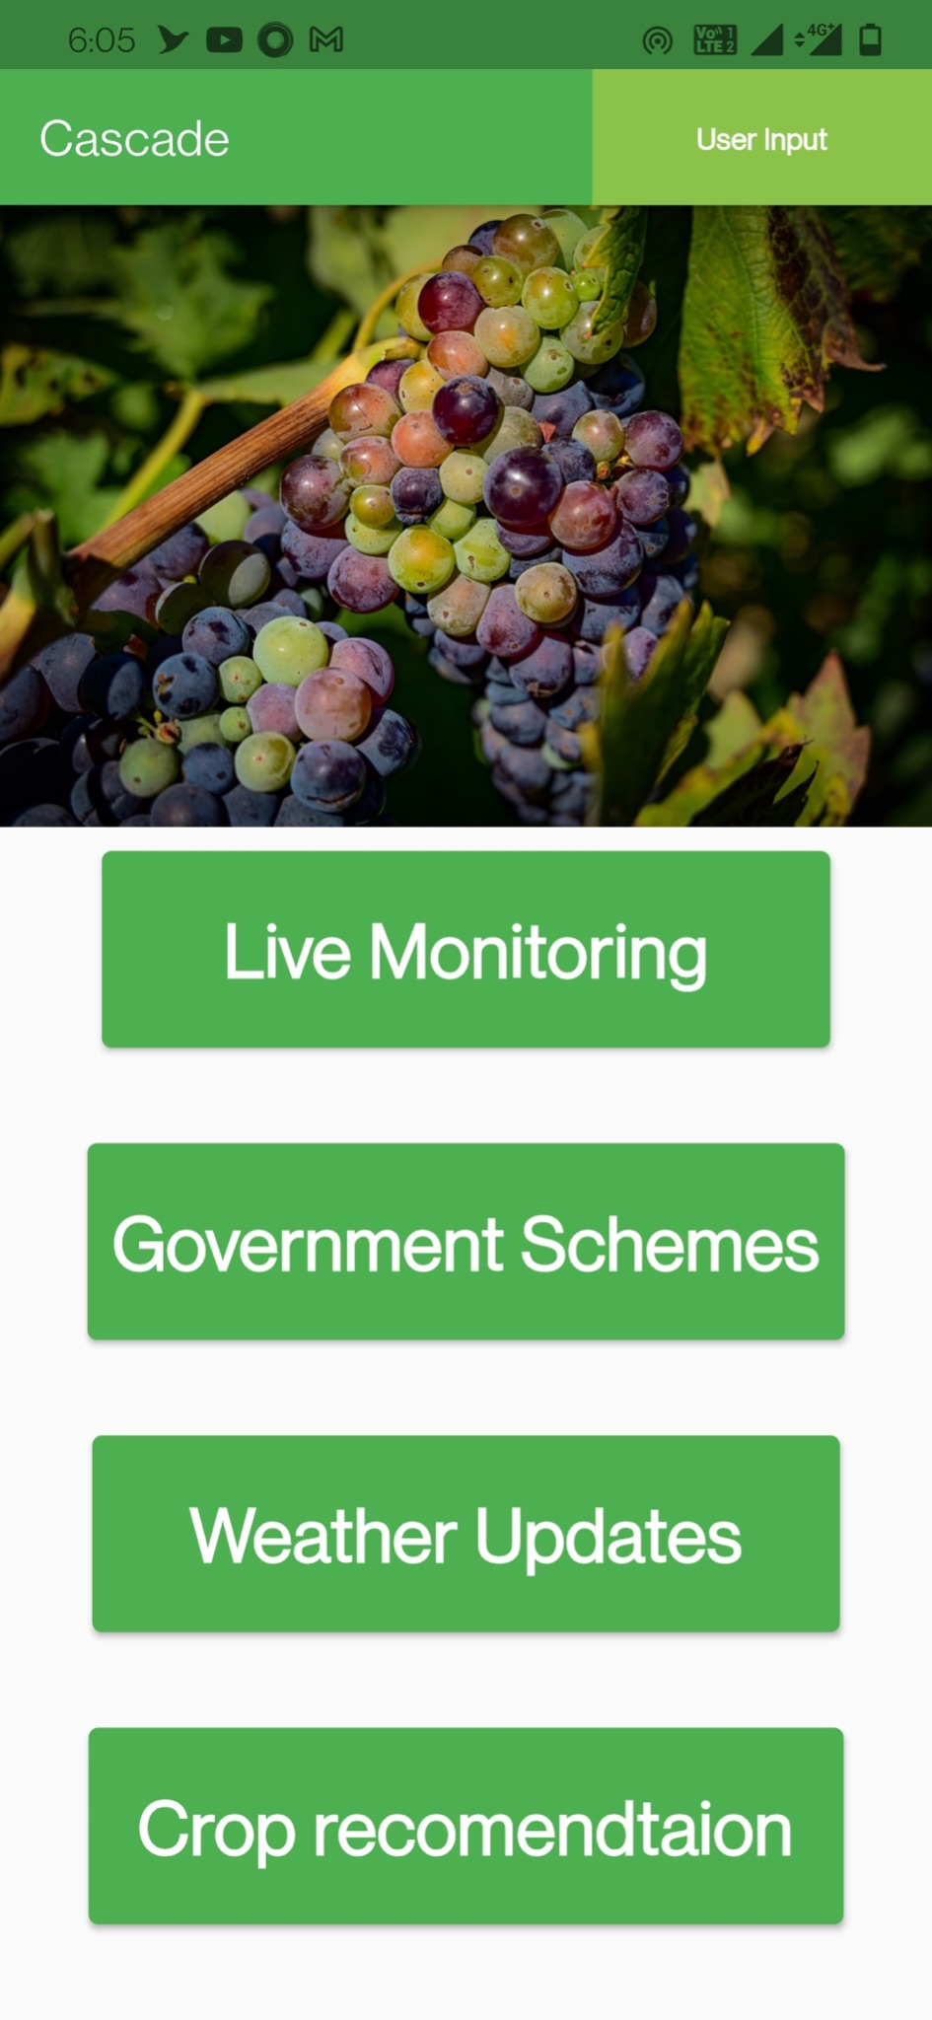
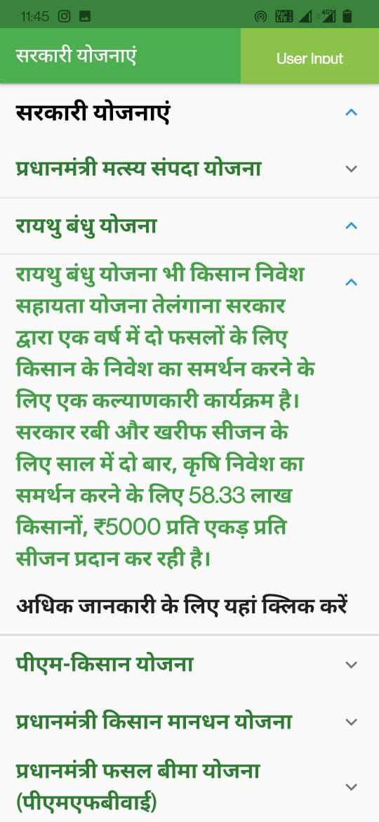

Slide 24
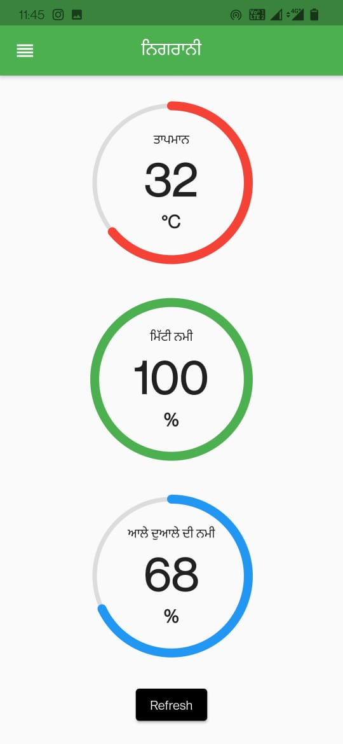
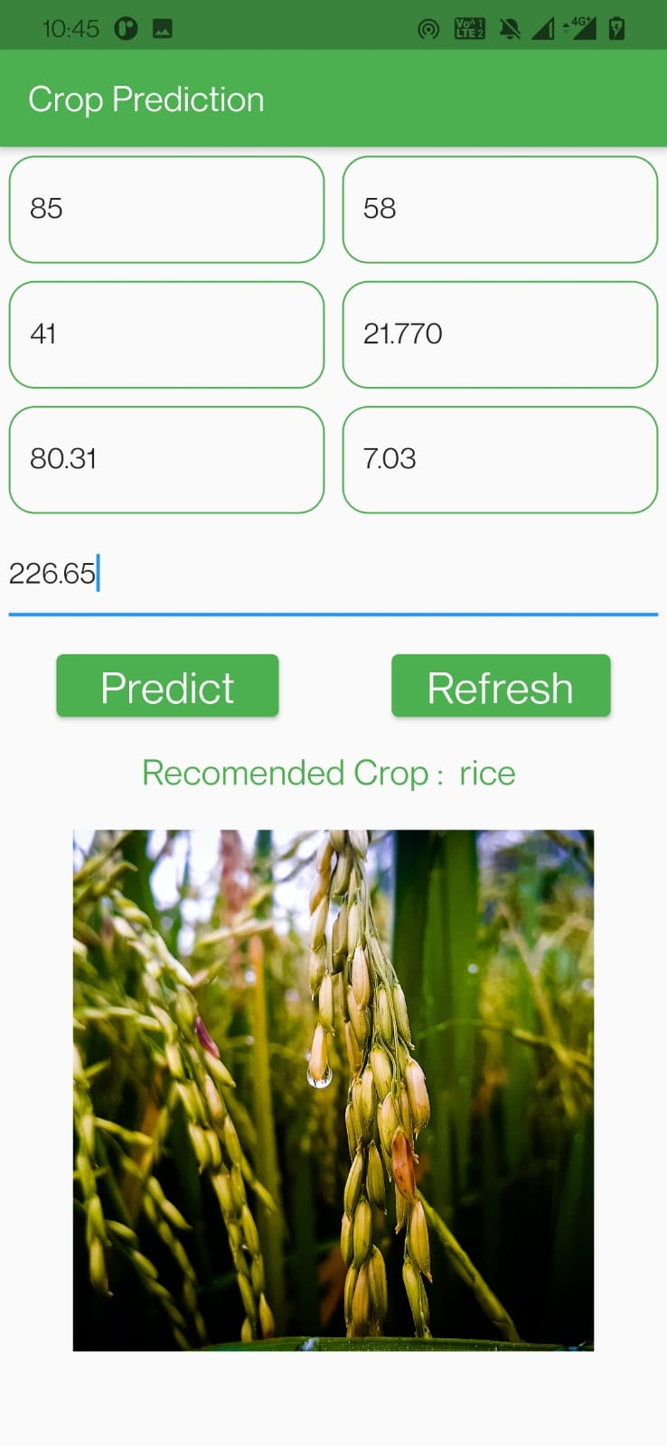
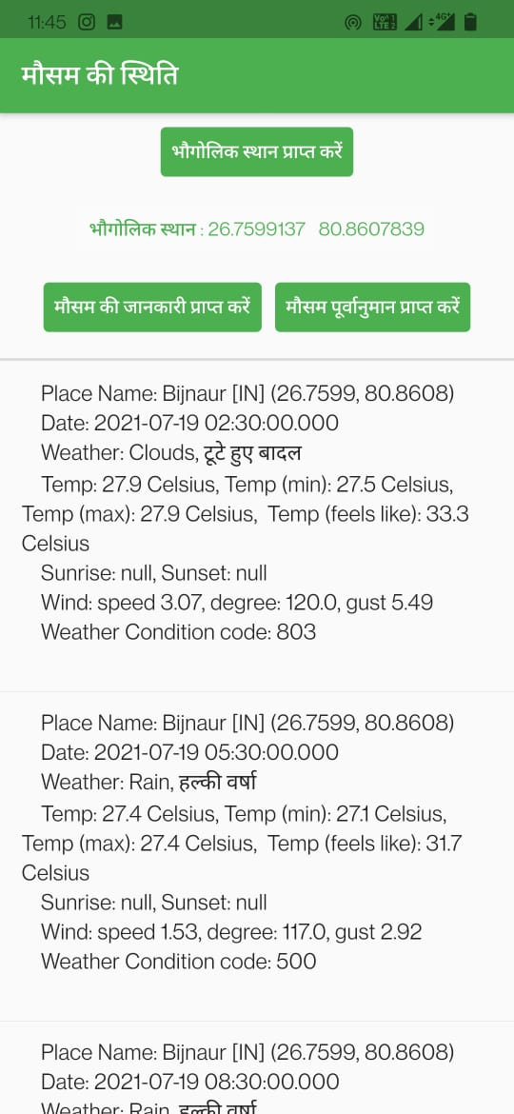

Slide 25
Final results for App Dev
App supports 3 languages : Punjabi , Hindi , and English
Crop recommendation .
App features live monitoring of surrounding temperature , humidity and soil moisture of the field .
App displays information about different government schemes.
Links are also present to redirect the user to the official page of different government schemes .
Based on the location of user app displays the weather forecasting without feeding the location details manually .

